Slide 1

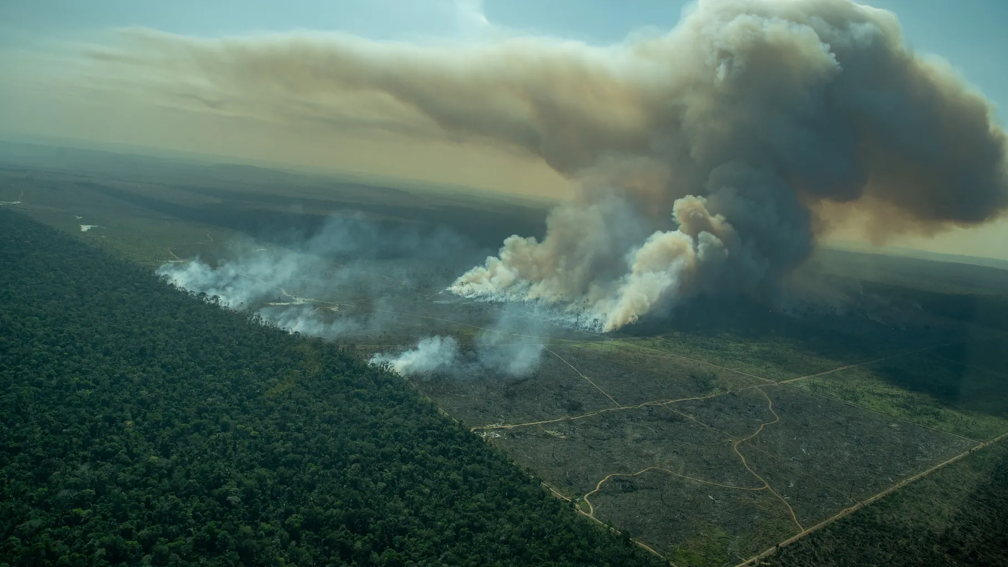




Tackling Wildfire Land Degradation in Brazil
Team “Pastéis de Nata”

Slide 2
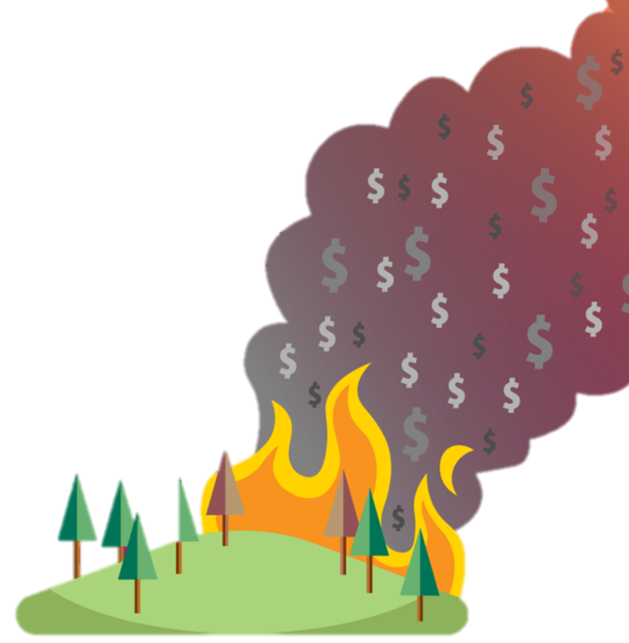



The Problem:
Estatisticas fogos: CO2, custos, vidas, especies
Solucoes atuais (merda o brazuca faz atualmente)
E nao prestam pq nao tem dados
Isto leva a degradacao solos
Nearly 3000
in Brazilian Amazon
in February,
new record
Amazon forest dieback due to the fires
could cost
Brazil up to
$3.5 trillion
Amazon rainforest
now emitting more CO₂ than it absorbs - annual fire emissions reach
1.5 billion tones
Pollution

Slide 3
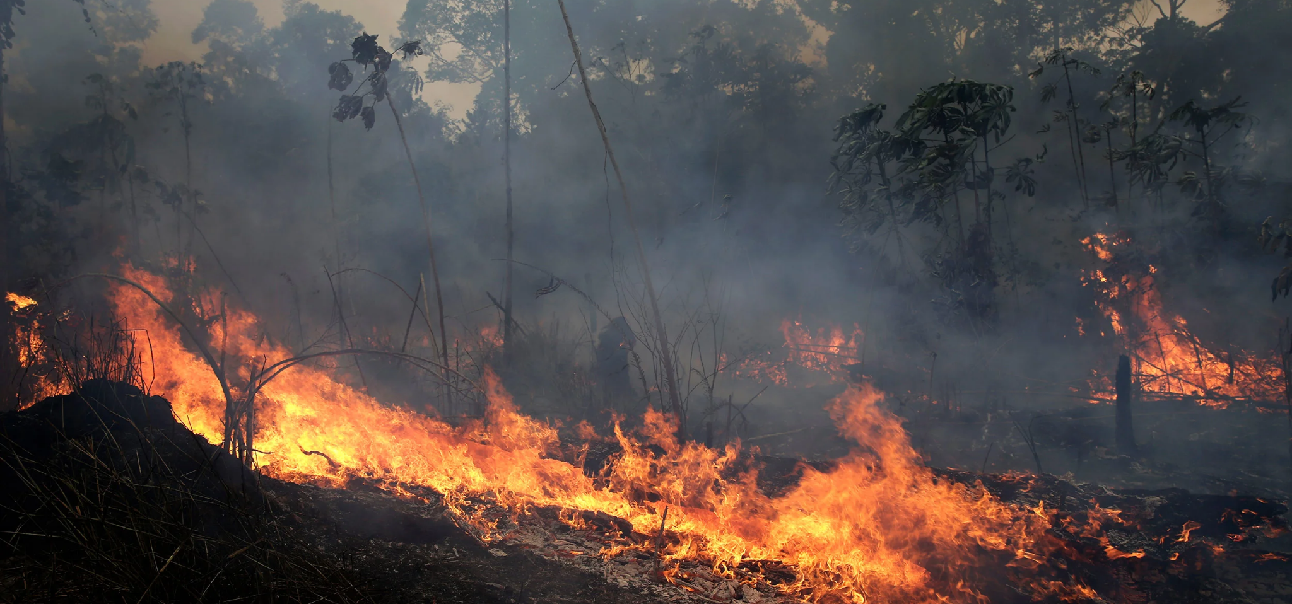
The Problem:
Addressing wildfires should go beyond fighting the flames.
Inefficient environmental and firefighting policies, and insufficient funding.
Uninformed decisions and lack of data analysis.

Slide 4



The Solution:
Leveraging historic data
Using a real-time pipeline
Developing a dashboard

Slide 5
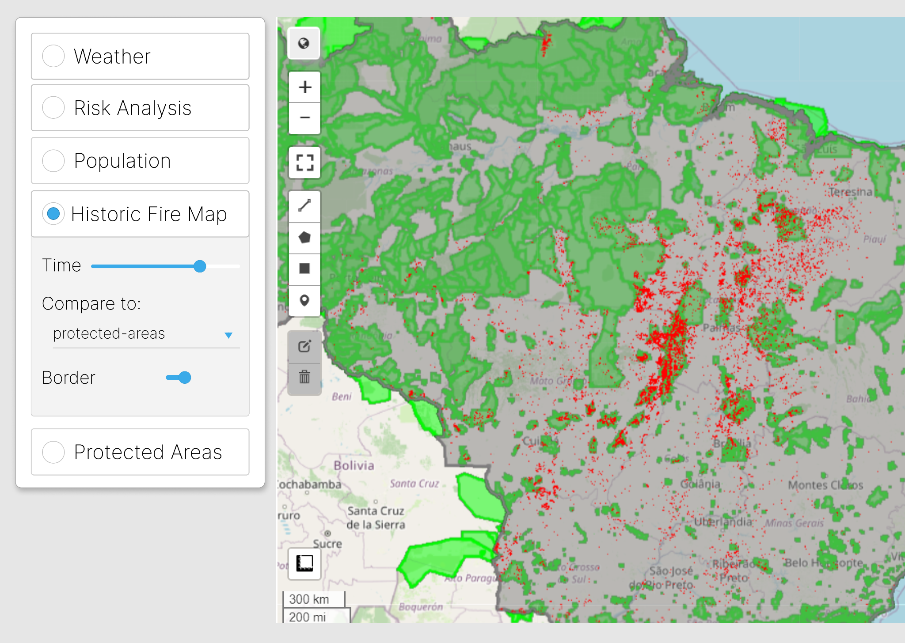
The Dashboard:

Slide 6
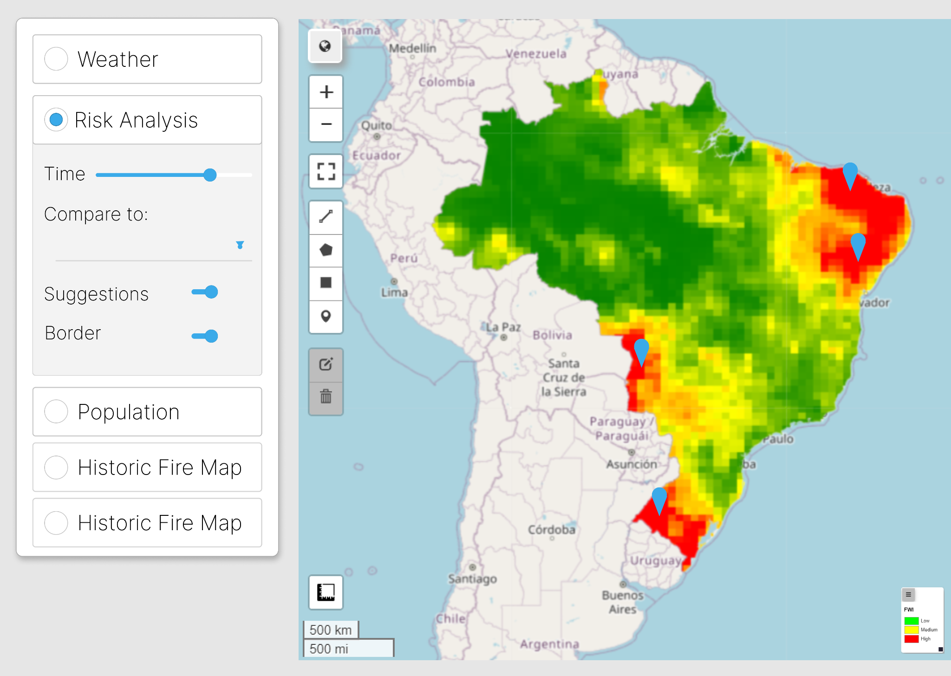






The Dashboard:
Data
Prediction
Proposal

Slide 7
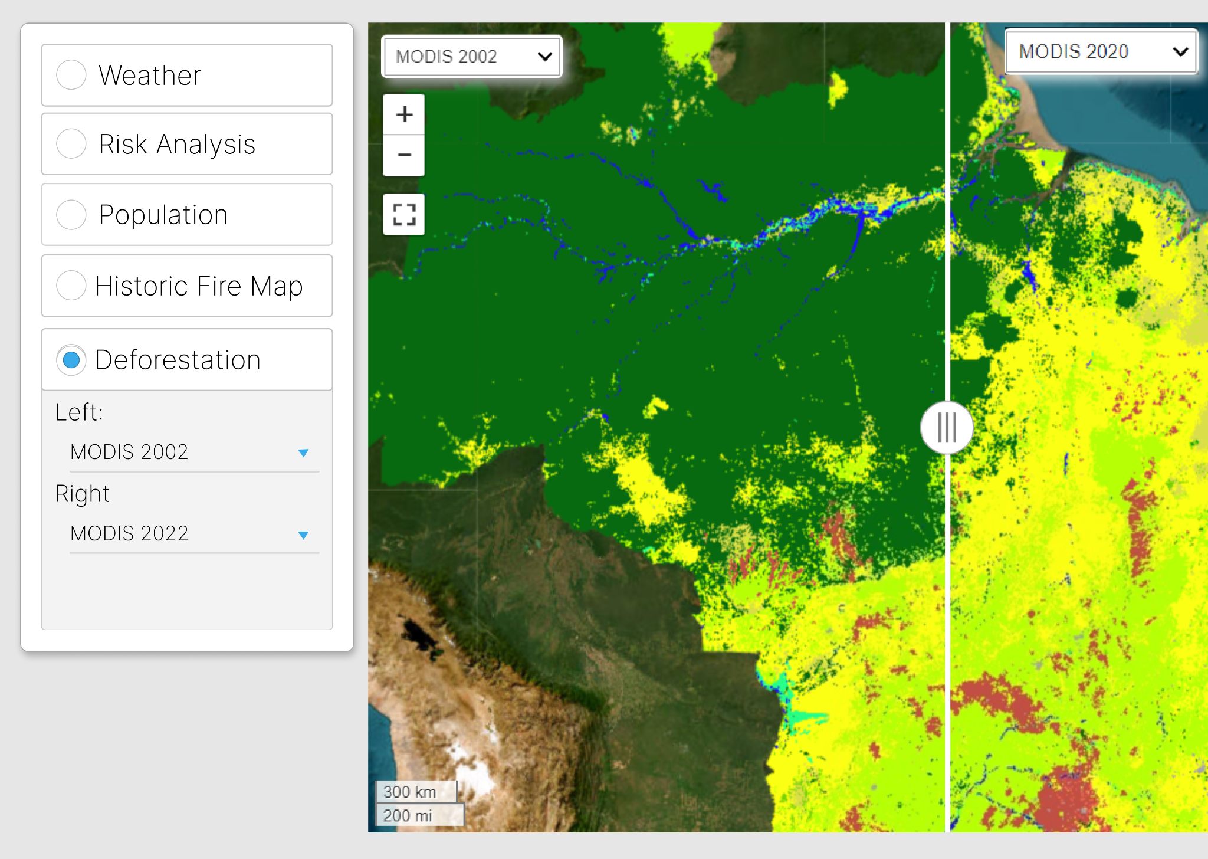
The Dashboard:

Slide 8
Thank you!
Team:
André Gomes
João Costa
Mariana Nunes
Tomás Mendoça

